Slide 1
Weather and farm animals in Mongolia
Correlation between number of farm animals and climate change
Notes:
Le nombre de chèvre a une incidence sur le climat en Mongolie?

Slide 2
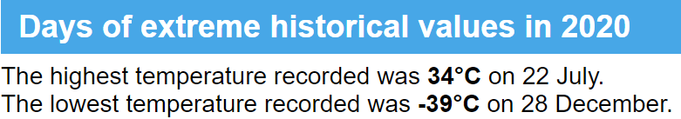
Between -30°in winter and 30°in summer
The climate is strongly continental, with long, frigid winters and short, warm summers.

Slide 3
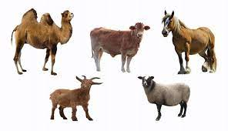
As precious as jewels : 5 snouts
The traditional herd animals of the Mongolians are horses, sheep, goats, cows and camels.

Slide 4
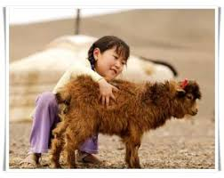
Why did I choose this topic?
A grant announced by the government for goats in 2008 is accused to improve number of goats which is ruining Mongolia’s grasslands and causing soil drought

Slide 5
Data source
Animal data (Mongolian Open data website)
https://www.1212.mn/tables.aspx?tbl_id=DT_NSO_1001_040V2&SOUM_select_all=1&SOUMSingleSelect=&LivestockPrice_select_all=0&LivestockPriceSingleSelect=_223&YearM_select_all=1&YearMSingleSelect=&viewtype=table
Weather data : (Worldbank climate knowledge portal)
https://climateknowledgeportal.worldbank.org/download-data

Slide 6
How did I proceed?
1
See if rise of average temperature is real
Compared to the rise of other animals, see if the rise of the number of goats is exceptional
4
See if there is a correlation between the rise of average temperature and the number of goats
2
3
See if there is a correlation between the rise of average temperature and the number of animals

Slide 7
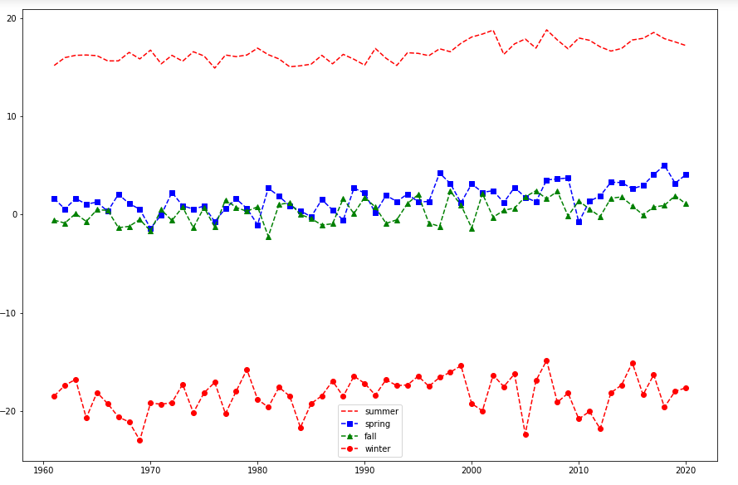
Average temperature by season since 1960
1
Correlation coefficient of temperature and rainfall is 0.8436

Slide 8
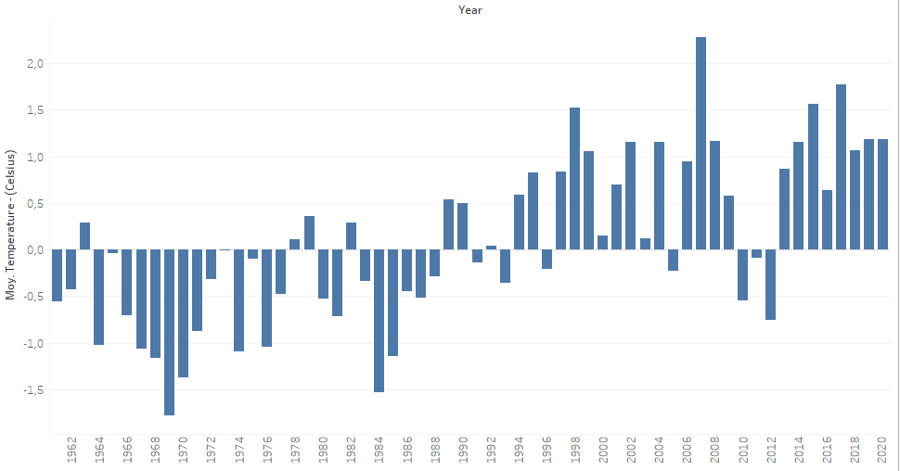
Average temperature per year since 1960
1

Slide 9
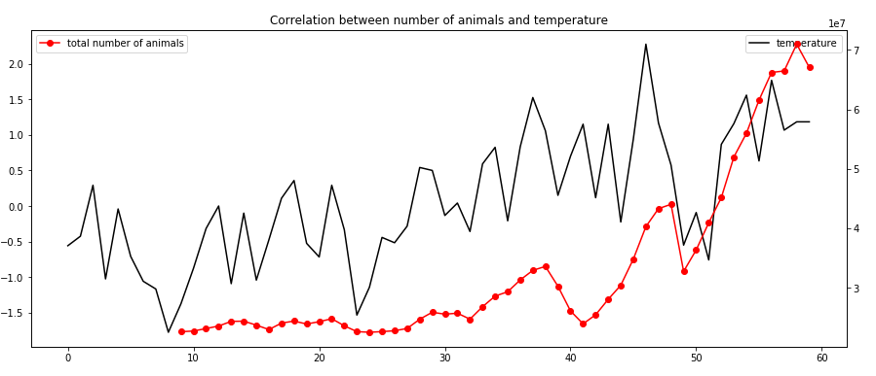
Correlation between average temperature per year and total number of animals
2
Correlation coefficient of temperature and total number of animals is 0.8436

Slide 10
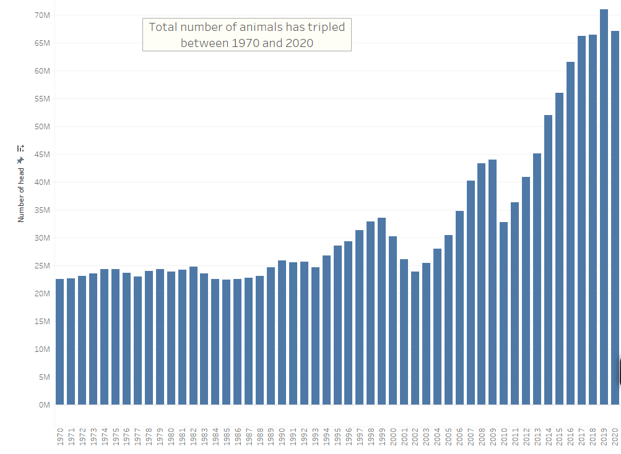
Rise of total number of animals between 1970 and 2020
3

Slide 11
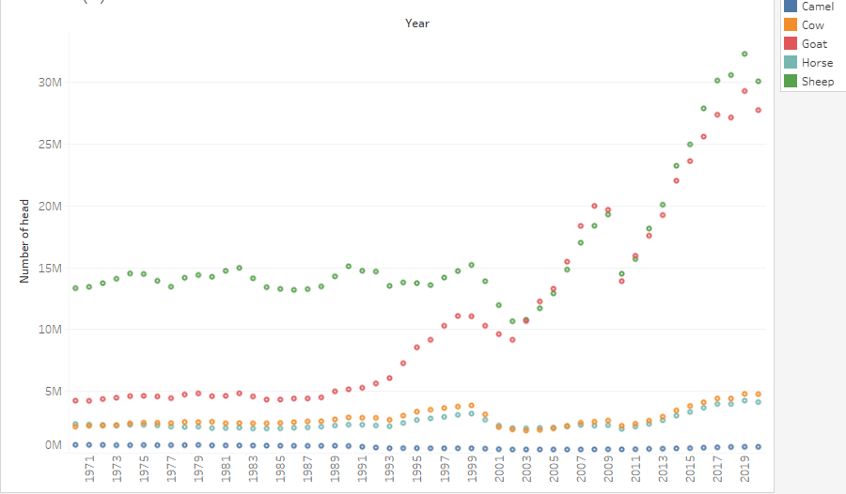
Rise of number of animals per type of animal between 1970 and 2020
3

Slide 12
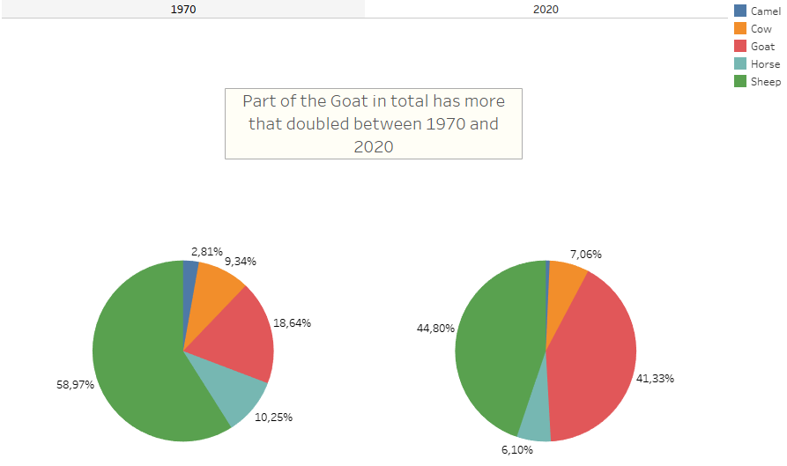
Part of goat in total number of animals 1970 vs 2020
3

Slide 13
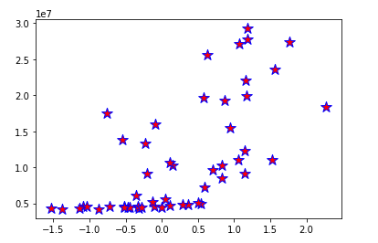
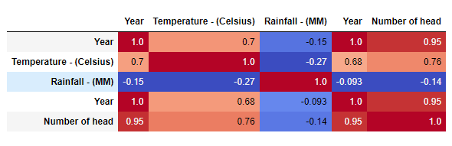
Correlation between number of goats and average temperature per year
4

Slide 14
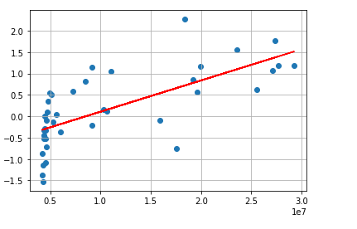
Univariate linear regression model
4

Slide 15
To conclude …
Difficulties
Credits
Retrieve data from multiple website
Volume of dataset
Translate data into english
Structured analysis
Use of statistical methods recently learnt
Want to go further

Slide 16
Going further …
Analysing data by region
Analysing economical data (rise of goat)
Analysing industrial data (rise of temperature)

